Slide 1

Building RAG with LLMs and Prompts
Jerry Liu, LlamaIndex co-founder/CEO

Slide 2
RAG

Slide 3

Context
LLMs are a phenomenal piece of technology for knowledge generation and reasoning. They are pre-trained on large amounts of publicly available data.
Use Cases
Question-Answering
Text Generation
Summarization
Planning
LLM’s

Slide 4
















Context
How do we best augment LLMs with our own private data?
Raw Files
API’s
?
Use Cases
Question-Answering
Text Generation
Summarization
Planning
Vector Stores
SQL DB’s
LLM’s

Slide 5
LlamaIndex: A data framework for LLM applications
Data Management and Query Engine for your LLM application
Offers components across the data lifecycle: ingest, index, and query over data
Data Ingestion (LlamaHub 🦙)
Data Structures
Queries
Connect your existing data sources and data formats (API’s, PDF’s, docs, SQL, etc.)
Store and index your data for different use cases. Integrate with different db’s (vector db, graph db, kv db)
Retrieve and query over data
Includes: QA, Summarization, Agents, and more

Slide 6
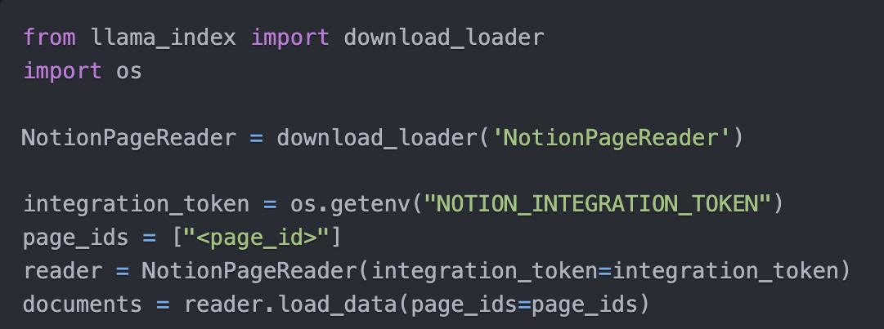
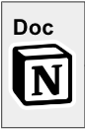
Data Connectors: powered by LlamaHub 🦙
Easily ingest any kind of data, from anywhere
into unified document containers
Powered by community-driven hub
rapidly growing (100+ loaders and counting!)
Growing support for multimodal documents (e.g. with inline images)
<10 lines of code to ingest from Notion

Slide 7
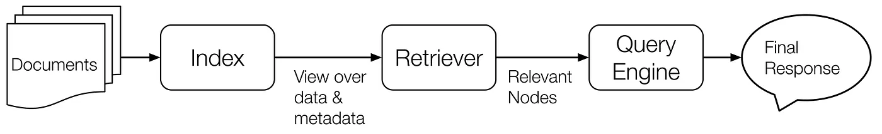
Data Indices + Query Interface
Your source documents are stored in a data collection
In-memory, MongoDB
Our data indices help to provide a view of your raw data
Vectors, knowledge graphs, keywords
A retriever helps to retrieve relevant documents for your query
A query engine manages retrieval and synthesis given the query.

Slide 8
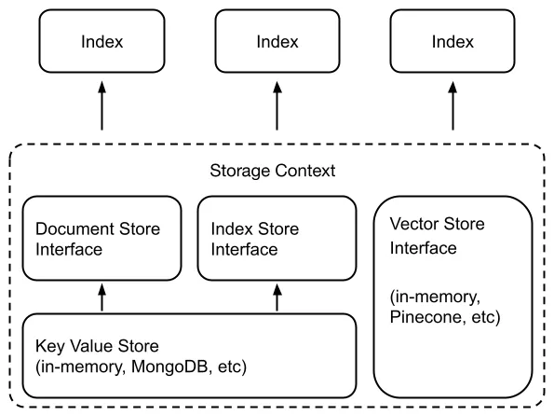
Storage Abstractions
KV Stores:
In-memory
MongoDB
S3
Vector Stores:
Pinecone
Weaviate
Chroma
Milvus
Faiss
Qdrant
Redis
Deeplake
Metal
DynamoDB
LanceDB
Opensearch
etc.

Slide 9
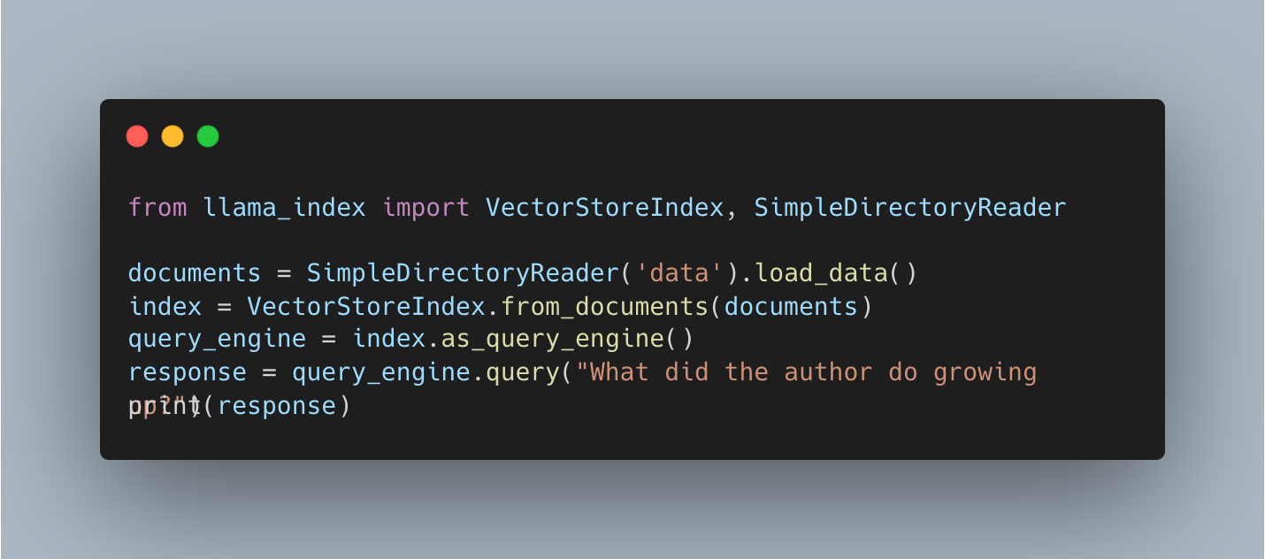

Slide 10
RAG Stack for building a QA System
Data Ingestion / Parsing
Data Querying
Chunk
Vector Database
Chunk
Doc
Chunk
Chunk
LLM
Chunk
Chunk
Chunk
5 Lines of Code in LlamaIndex!

Slide 11
RAG Stack (Data Ingestion/Parsing)
Current State:
Load in documents into a text representation (e.g. from LlamaHub)
Split up document(s) into even chunks (by sentences, or by tokens)
Load into vector database
Chunk
Vector Database
Chunk
Doc
Chunk
Chunk

Slide 12
Naive RAG Stack (Querying)
Current State:
Find top-k most similar chunks from vector database collection
Plug into LLM Response Synthesis Module
Vector Database
This is RAG Prompt Engineering
Chunk
LLM
Chunk
Chunk

Slide 13
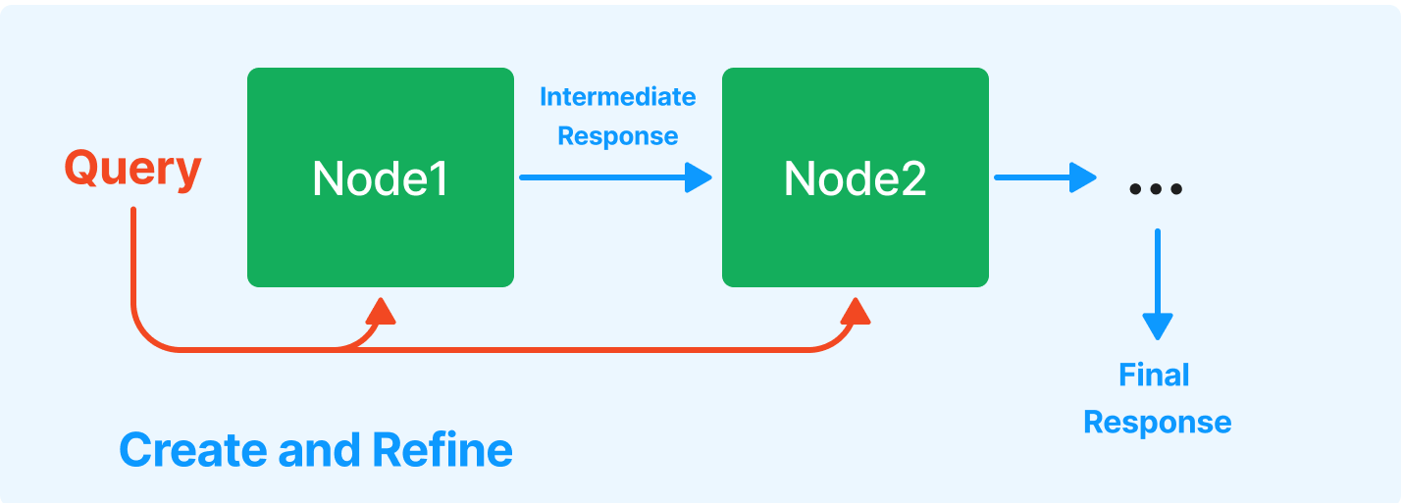
Response Synthesis
Create and refine

Slide 14
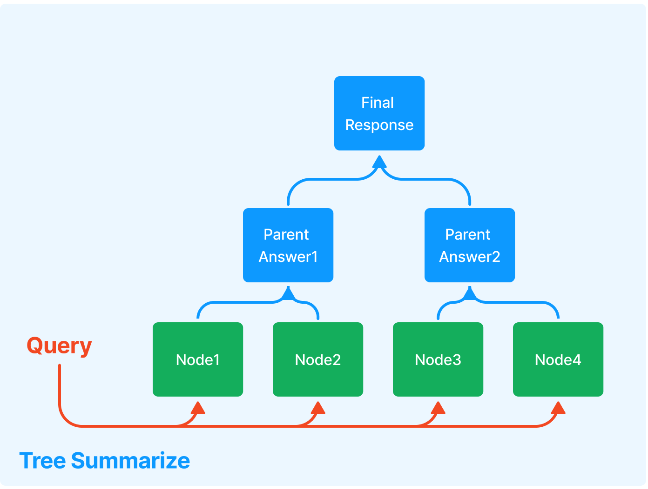
Response Synthesis
Tree Summarize

Slide 15

Let’s Build LLM Response Synthesis!
https://colab.research.google.com/drive/15Qk6cXCj8U5RcvdykGSRdWemn497Dqcv?usp=sharing

Slide 16
Challenge with RAG Stack
Top-k retrieval can be limiting - works mostly for questions about specific facts
What if we wanted to ask summarization questions?

Slide 17
Summary Index: Returns All Context
from llama_index import SummaryIndex, SimpleDirectoryReader
documents = SimpleDirectoryReader('data').load_data()
index = SummaryIndex.from_documents(documents)
query_engine = index.as_query_engine(response_mode="tree_summarize")
response = query_engine.query("Could you give a summary of this article in newline separated bullet points?")
Answer
The author began writing and programming before college, and studied philosophy in college before switching to AI.
He realized that AI, as practiced at the time, was a hoax and decided to focus on Lisp hacking instead.
He wrote a book about Lisp hacking and graduated with a PhD in computer science.
….

Slide 18
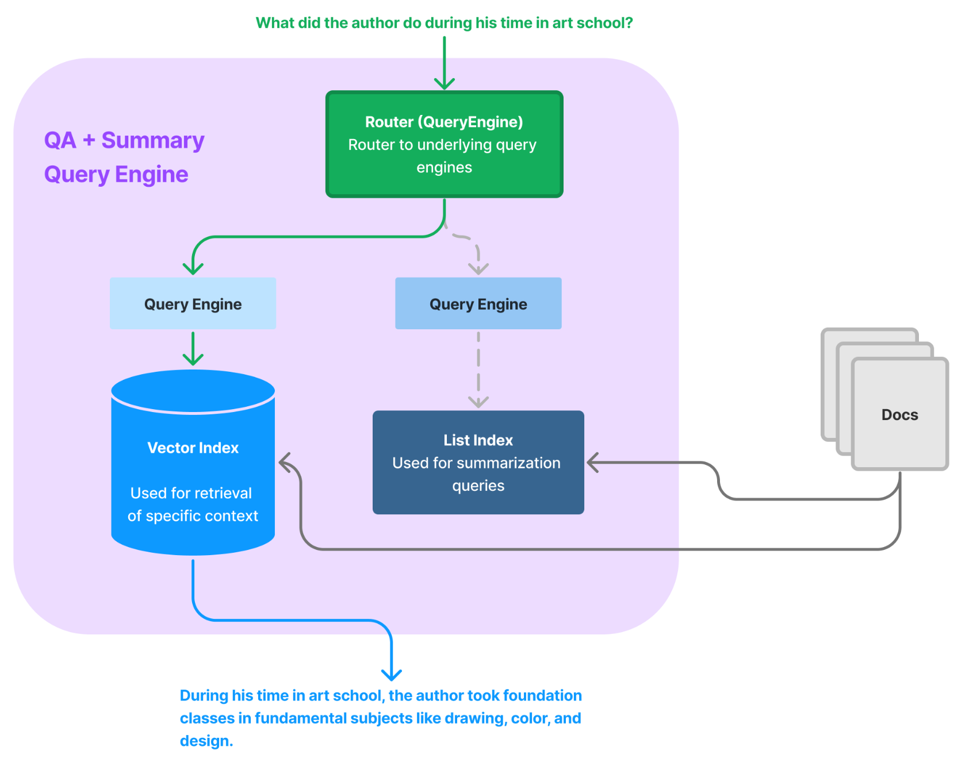
Building a Unified Query Interface
Can use a “Router” abstraction to route to different query engines.
For instance, can do joint semantic search / summarization

Slide 19
Considerations when building Router
Deciding whether to select one option or multiple options
How to do structured output parsing
Integrating with Function Calling APIs
[Multi-Routing] Figuring out how to Combine Results

Slide 20

Let’s build a Router!
https://colab.research.google.com/drive/19cmfRyWR-5t0exWedMmK0WElUdoxfFnv?usp=sharing

Slide 21
(If Time) Data Agents

Slide 22

Data Agents - LLM-powered knowledge workers
Email
Analysis Agent
Read latest emails
Analyze
file
Retrieve
context
Send update
Data
Agent
Knowledge Base
Slack

Slide 23
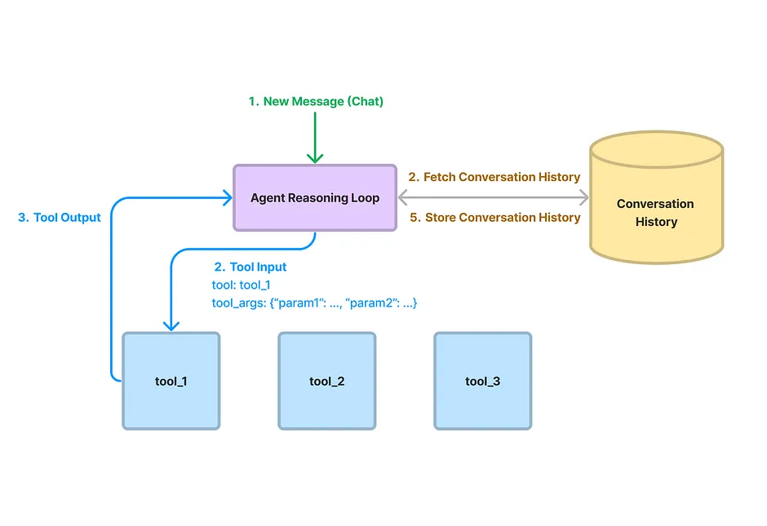
Data Agents - Core Components
Agent Reasoning Loop
ReAct Agent (any LLM)
OpenAI Agent (only OAI)
Tools via LlamaHub
Code interpreter
Slack
Notion
Zapier
… (15+ tools, ~100 loaders)

Slide 24
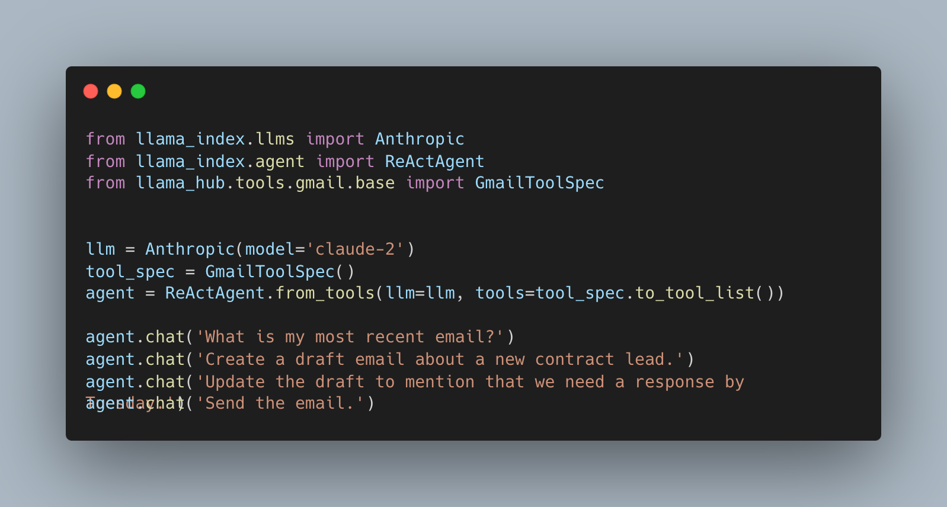
Build an Agent

Slide 25
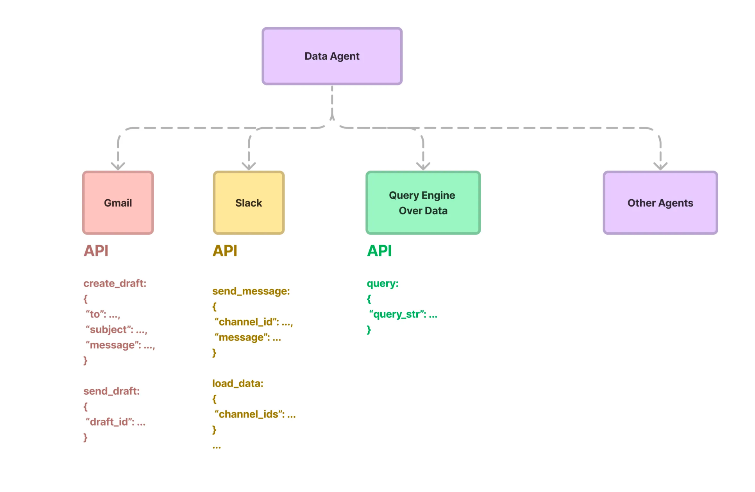
Data Agents - Advanced
Query engine as data tool
Index & retrieve different types of data (e.g. semi-structured)
Hierarchical agents
Define specialized agent that top-level agent route request to
Utility tools
Handle large API response
Tool retrieval
Handle large number of APIs
Robust tool design
Make API calling more reliable

Slide 26
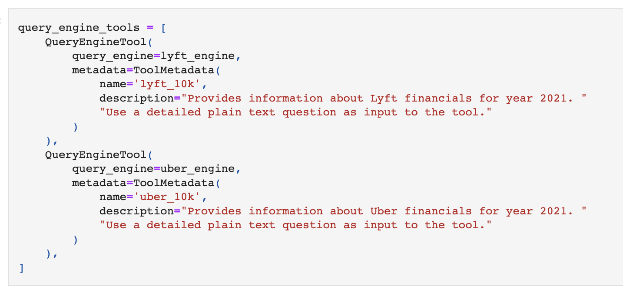
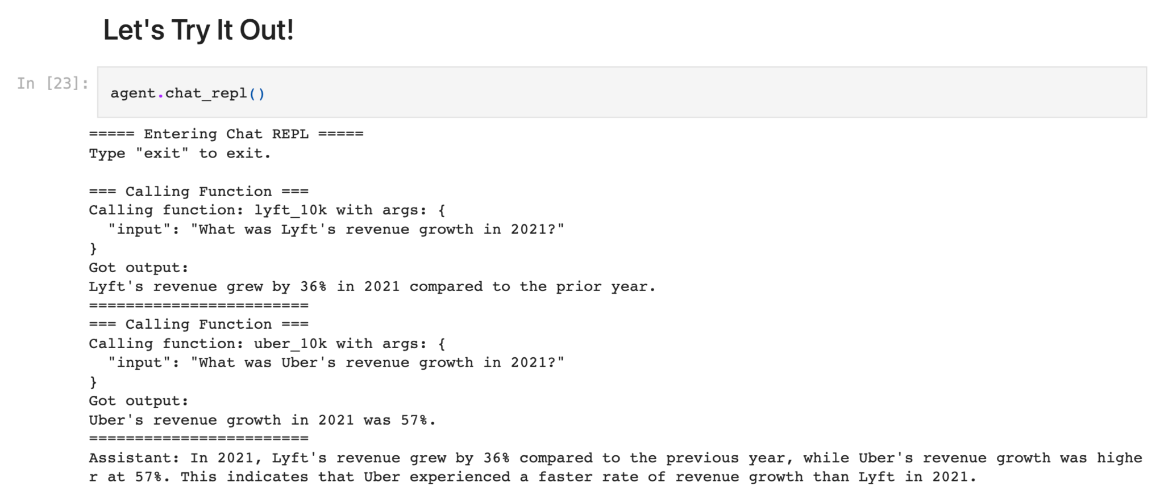
How to retrieve & analyze data from knowledge base?
Use our query engines as “data tools” over your agent:
Semantic search
Summarization
Text-to-SQL
Document comparisons
Combining Structured Data w/ Unstructured
“Simple” Interface - all agent has to infer is a query string!
Example Notebook:
OpenAI Agent + query engines (as tools)
Analyzing structured + unstructured data

Slide 27
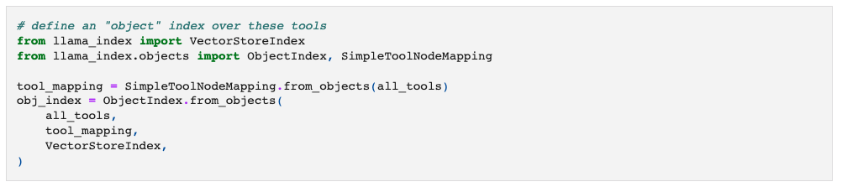
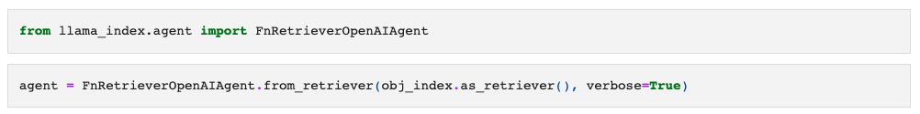
How to handle large number of tools?
Build an index over your tools, and retrieve the most relevant ones to pass to your agent.
Example Notebook

Slide 28
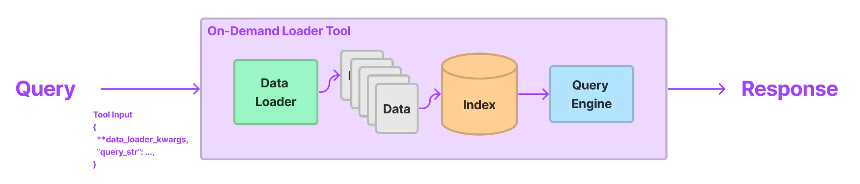
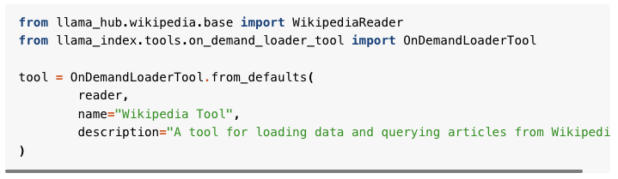
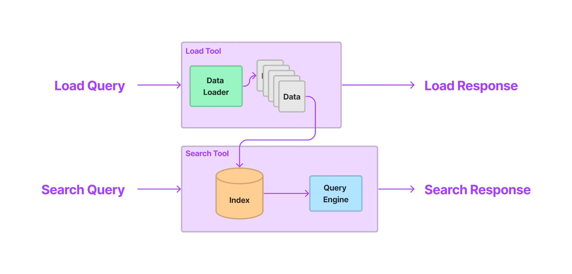
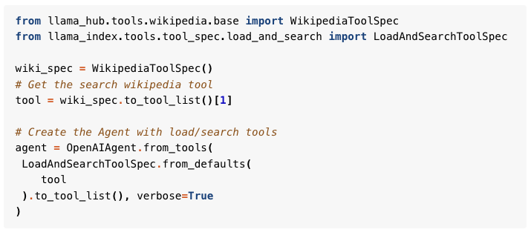
How to handle large responses from tools?
OnDemandLoaderTool
LoadAndSearchToolSpec

Slide 29
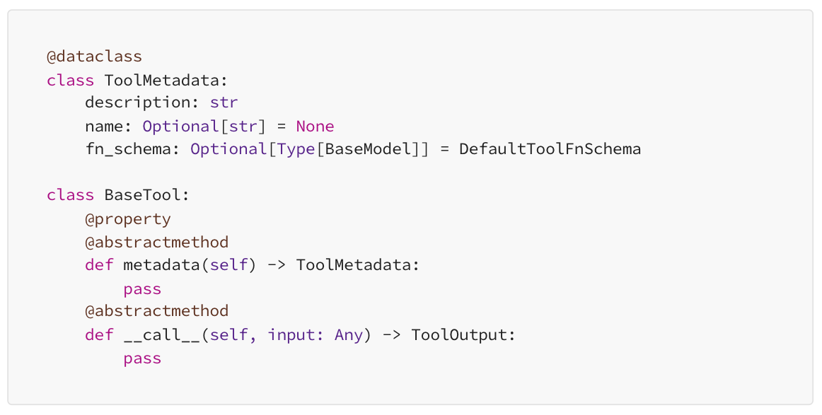
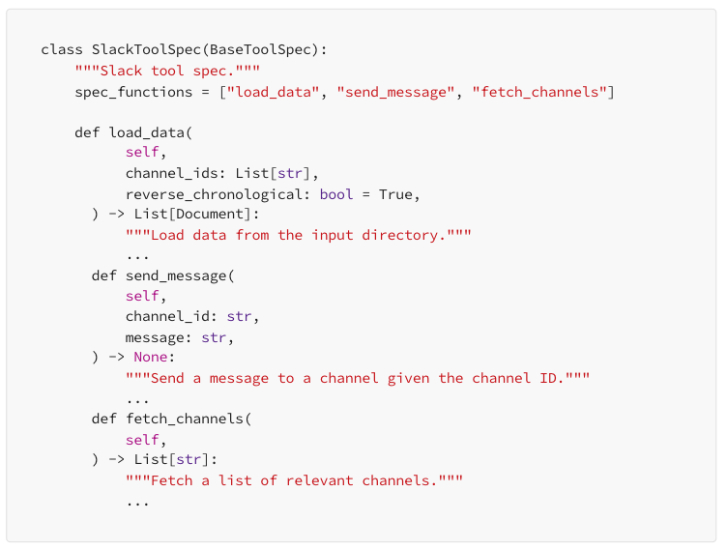
How to build better tools?
Write useful tool prompts
Make tools tolerant of partial inputs
Validating input and agent error handling
Provide simple functions related to the tool
Returning prompts from functions that perform mutations
Storing large responses in indices for the Agent to read
Verify how the Agent understands the tool
Full guide

Slide 30
Ideas to explore
Automatic tool creation from clients/APIs in the wild
Drop-in context engine for agent apps
Invisible agents
Proactive agents

Slide 31
Ideas to explore
Automatic tool creation from clients/APIs in the wild
Drop-in context engine for agent apps
Invisible agents
Proactive agents

Slide 32
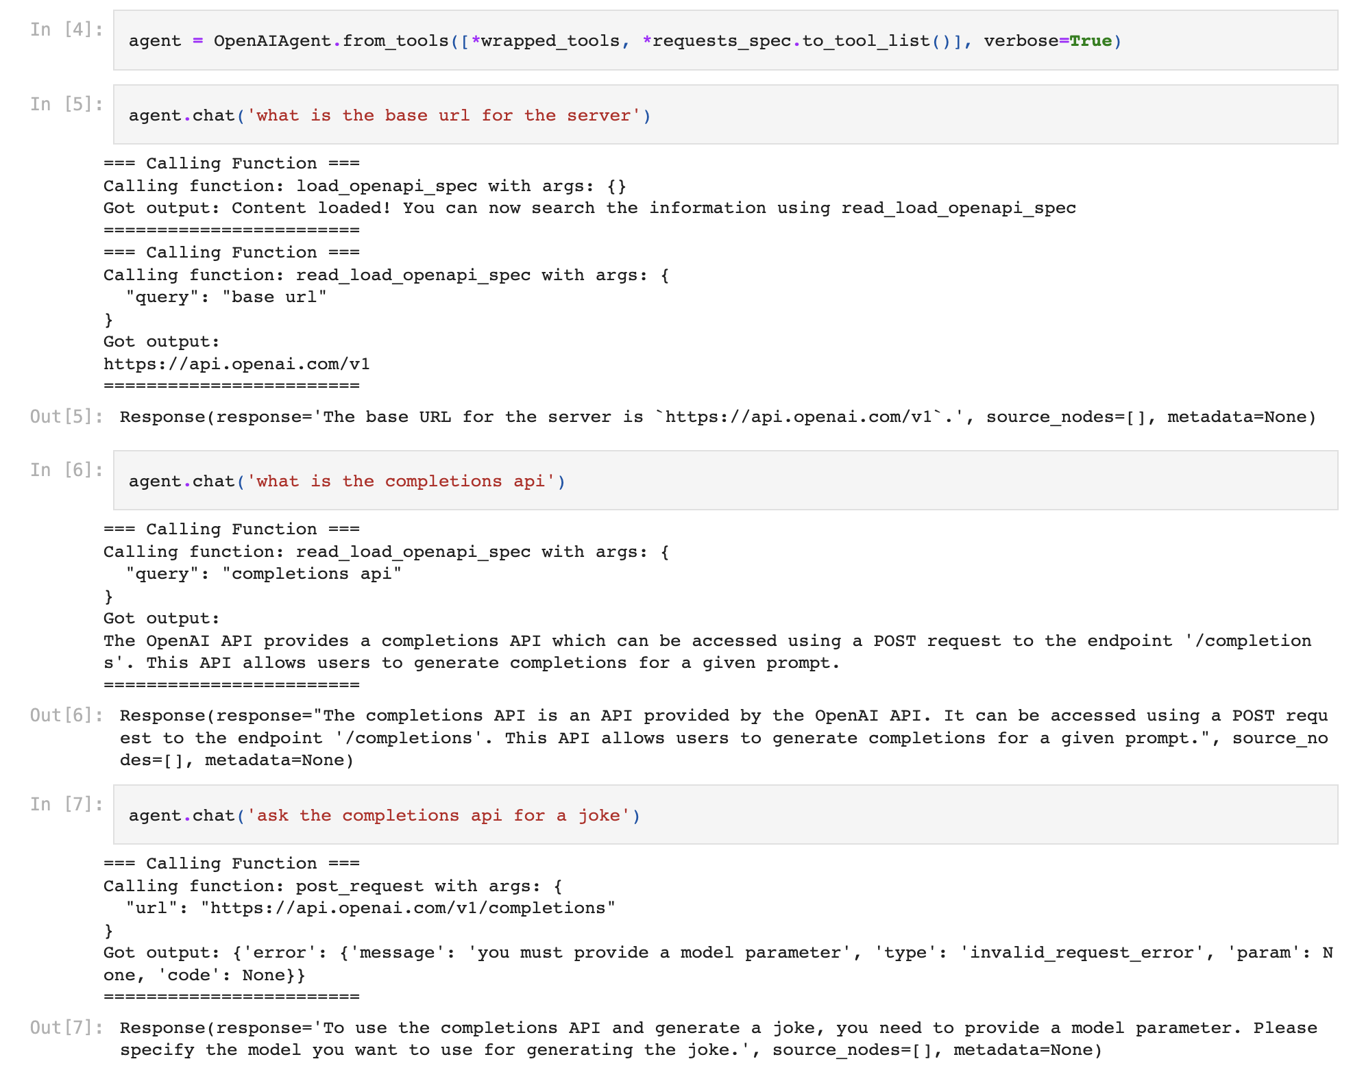
Query any API as a Tool
The OpenAPI Spec is a cheat code - implicitly create “tool” from any service using OpenAPI!
Problem: Responses can be quite large (see OpenAI spec as an example)
Solution: Index/cache the response first,
Additional Challenges:
Human usable API is not the same as agent usable API…
Full guide

Slide 34
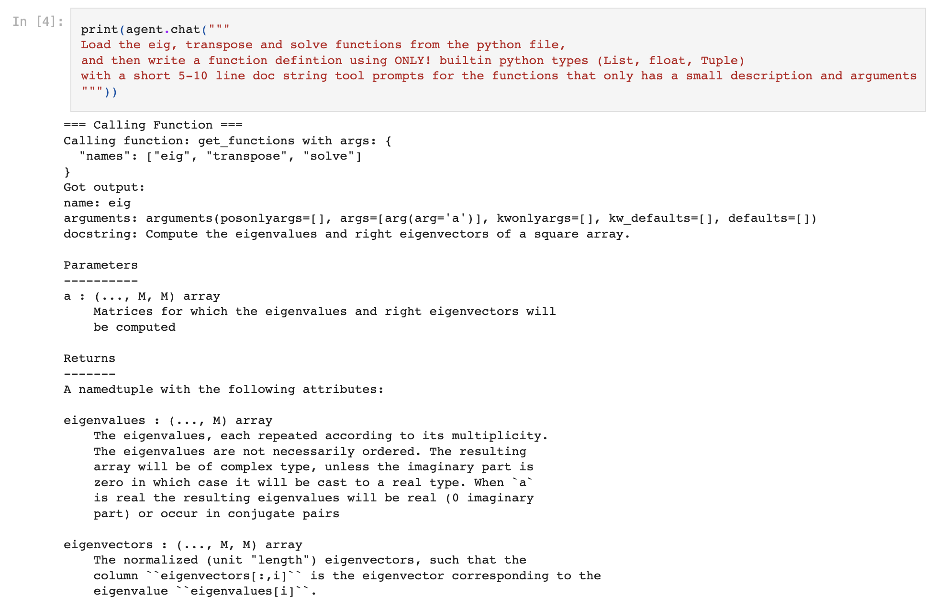
Create Tools from Python Functions (WIP)
Read any Python File, generate a Tool Spec from it with a “tool generator agent”
This tool spec can then be plugged into any other downstream agent
Full guide

